Slide 1

Computing Algorithms Lecture 3: Fundamentals of the Analysis of Algorithm Efficiency part 2
By: Dr. Mohamed Moheeb

Slide 2
Agenda
Mathematical Analysis of Non-recursive Algorithms
Mathematical Analysis of Recursive Algorithm
Empirical Analysis of Algorithms

Slide 3

Mathematical Analysis of Non-recursive Algorithms

Slide 4
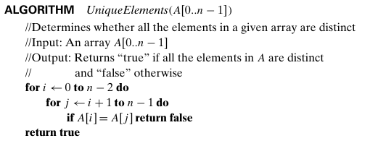


Mathematical Analysis of Non-recursive Algorithms
T(n)= $\sum_{i=0}^{n−2}{\sum_{j=i}^{n−1}{1}}$= $\sum_{i=0}^{n−2}{\left(n−1−i+1\right)1 }$
= (First +Last)size /2
= (n+1)(n-1)/2
= ${(n}^{2}−1)/2$
First = (n-1-i+1) where i=0 = n
Last= (n-1-i+1) where i=n-2 = (n-1-(n-2)+1)=(n-1-n+2)=1
Size= n-2-0+1= n-1
1 comparison
Θ($n^{2})$

Slide 5
Mathematical Analysis of Recursive Algorithms

Slide 6
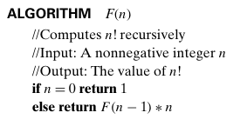
Mathematical Analysis of Recursive Algorithms
For recursive algorithm depends on creating a recurrent relationship
F(n)= F(n-1) +1 (1 is the number of basic operation)
The stopping condition:
F(0) = 0 (as there is no multiplication)
1 multiplication

Slide 7

How to solve the recurrent relationship
First Expand the recurrence to observe a pattern
Second Identify the stopping condition and assume it is equal to pattern
Third Substitute the depth $k$ back into the pattern form.

Slide 8
Expand the recurrence to observe a pattern
F(n)= F(n-1) +1= or we can rewrite to be a function of time T(n)= T(n-1) +1 eq.(1)
T(n-1)= T(n-2) +1 eq.(2) because every time we call the function 1 basic operation is invoked
T(n-2)= T(n-3) +1 (3)
We can substitute T(n-1) from equation 1 by equation 2
T(n)=T(n-1) +1
T(n)=T(n-2) +1 +1 (4)
We can also substitute T(n-2) from equation 3 by equation 4
T(n)=T(n-2) +1 +1
T(n)=T(n-3) +1 +1 +1 (5)
We can check the pattern that when
T(n-1) then +1
T(n-2) then +2
T(n-3) then +3
The pattern can be written as :
T(n)=T(n-k) +k

Slide 9
Identify the stopping condition
Given that the general pattern is
T(n)=T(n-k) +k
Given that the T(n-k) will decrease till it reach the stopping condition T(0)=0
Assume that T(n-k)=T(0)=0
Since function T( value 1) = T( value 2) then the two values must be equal each other
Then value1=value2
Then n-k=0
n-k=0
Then k = n

Slide 10


Substitute the depth $k$ back into the pattern form
Since k=n-1
In pattern T(n)=T(n-k) +k substitute with k=n
T(n)= T(n-(n-1)) +k =T(0)+ n
Since T(0)= 0 then by substitute in pervious equation
T(n)= 0 + n
T(n)= n
Θ(n$)$

Slide 11
Example 2:
T(n)= 2T(n-1) eq.(1) T(1)=1
T(n-1)=2T(n-2) eq.(2)
T(n-2)=2T(n-3) eq.(3)
substitute T(n-1) with 2T(n-2)
T(n)= 2(2T(n-2)) eq. (4)
Substitute T(n-2) with 2T(n-3)
T(n)= 2(2(2T(n-3))) eq.(5)
Θ($n^{2})$

Slide 12
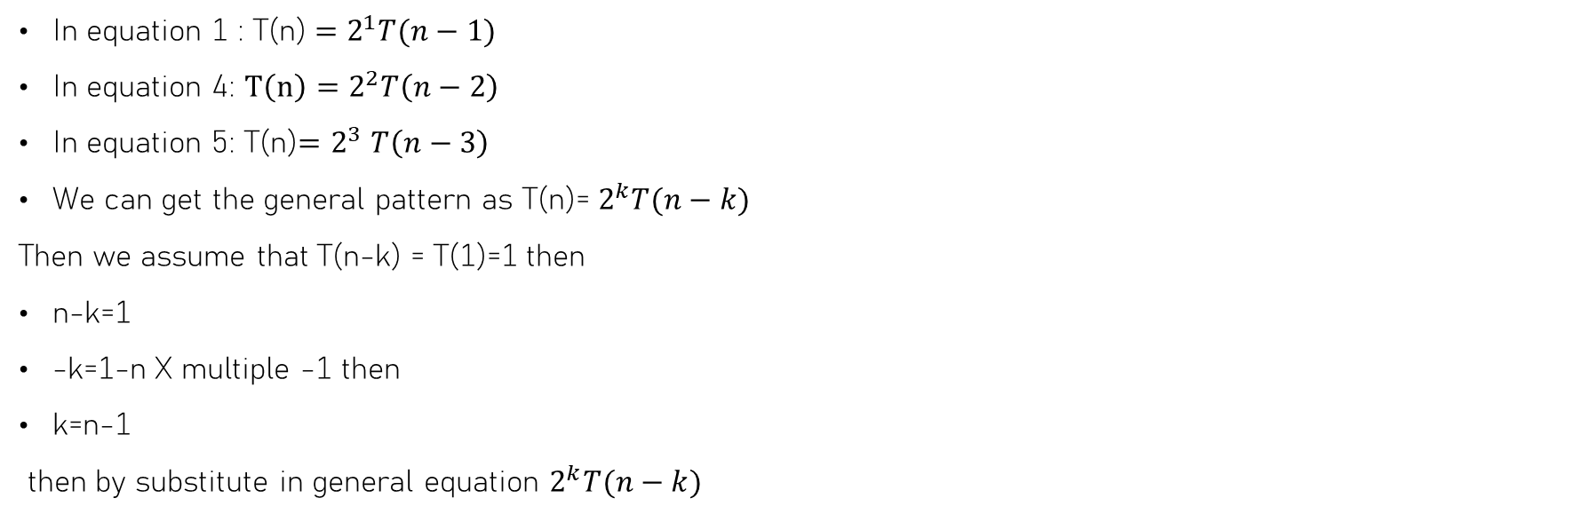
Example 2:
In equation 1 : T(n) $=2^{1}T(n−1)$
In equation 4: $T\left(n\right)=2^{2}T\left(n−2\right)$
In equation 5: T(n)${=2}^{3}T\left(n−3\right)$
We can get the general pattern as T(n)= $2^{k}T(n−k)$
Then we assume that T(n-k) = T(1)=1 then
n-k=1
-k=1-n X multiple -1 then
k=n-1
then by substitute in general equation $2^{k}T(n−k)$

Slide 13

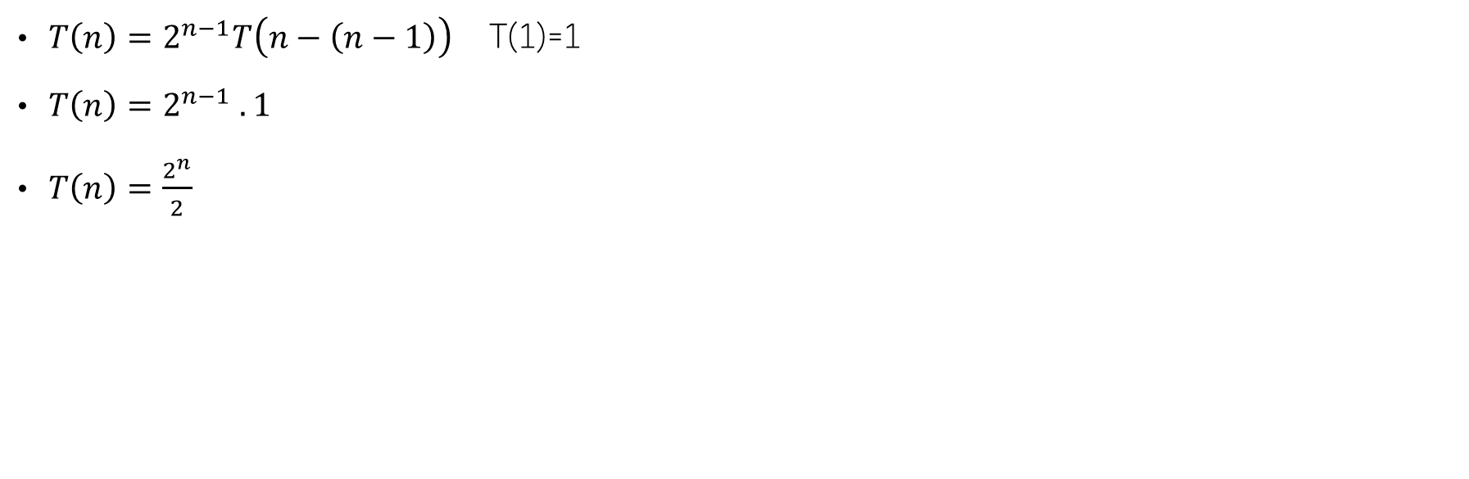
Example 2:
${T\left(n\right)=2}^{n−1}T\left(n−\left(n−1\right)\right)$ T(1)=1
${T\left(n\right)=2}^{n−1} . 1$
$T\left(n\right)=\frac{2^{n}}{2}$
Θ($2^{n})$

Slide 14
Example 3:
T(n)= T(n/2) +1 eq.(1) T(1)=1
T(n/2)=T(n/4) +1 eq.(2)
T(n/4)=T(n/8) +1 eq.(3)
substitute T(n/2) with T(n/4)+1
T(n)= T(n/4) +1 +1 eq. (4)
Substitute T(n/4) with T(n/8) +1
T(n)= T(n/8) +1+1+1 eq.(5)

Slide 15

Example 3:
In equation 1 : T(n) $=T\left(\frac{n}{2}\right)+1$
In equation 4: $T\left(n\right)=T\left(n/4\right)+2=T\left(\frac{n}{2^{2}}\right)+2$
In equation 5: T(n)$= T\left(n/8\right)+3=T\left(\frac{n}{2^{3}}\right)+3$
We can get the general pattern as T(n)= $T\left(\frac{n}{2^{k}}\right)+k$
Then we assume that $T\left(\frac{n}{2^{k}}\right)$= T(1)=1 then
$\frac{n}{2^{k}}=$1 preform cross multiplication
$n=2^{k}$ preform log rule
k= $\log_{2}{k}$
then by substitute in general equation T(n)= $T\left(\frac{n}{2^{k}}\right)+k$

Slide 16

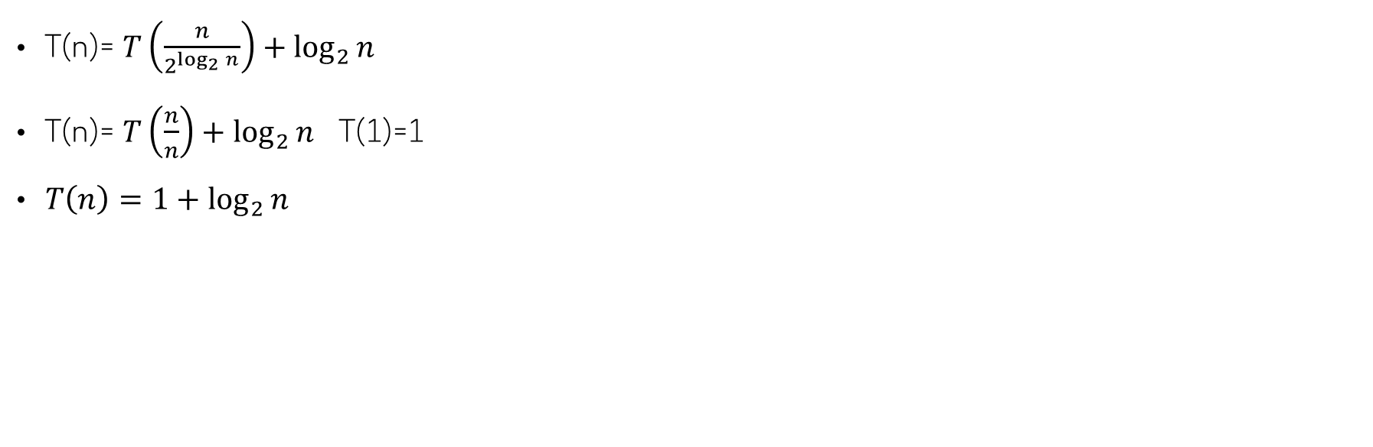
Example 3:
T(n)= $T\left(\frac{n}{2^{\log_{2}{n}}}\right)+\log_{2}{n}$
T(n)= $T\left(\frac{n}{n}\right)+\log_{2}{n}$ T(1)=1
$T\left(n\right)=1+\log_{2}{n}$
Θ(logn$)$

Slide 17
Example 4:
T(n)= T(n-1) +n eq.(1) T(1)=1
T(n-1)=T(n-2) +n-1 eq.(2)
T(n-2)=T(n-3) +n-2 eq.(3)
substitute T(n-1) with T(n-2)+ n-1
T(n)= T(n-2) +n-1 +n eq. (4)
Substitute T(n-2) with T(n-3) +n-2
T(n)= T(n-3) +n-2+n-1+n eq.(5)

Slide 18

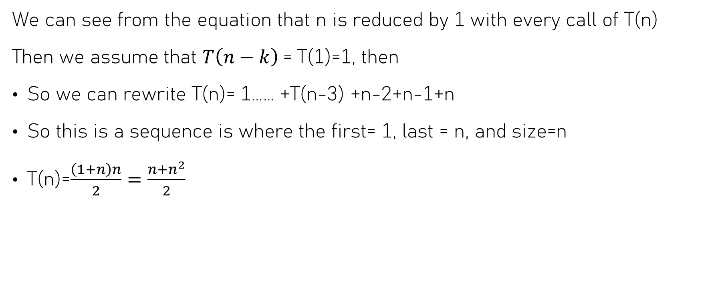
Example 4:
We can see from the equation that n is reduced by 1 with every call of T(n)
Then we assume that $T\left(n−k\right)$= T(1)=1, then
So we can rewrite T(n)= 1…… +T(n-3) +n-2+n-1+n
So this is a sequence is where the first= 1, last = n, and size=n
T(n)=$\frac{\left(1+n\right)n}{2}=\frac{n+n^{2}}{2}$
Θ($n^{2})$

Slide 19
Example 5 (hard)
T(n)=T(n/2) + n eq.(1), T(1)=1
T(n/2)= T(n/4) + n/2 eq.(2)
T(n/4)= T(n/8) + n/4 eq.(3)
substitute T(n/2) with T(n/4)+ n/2
T(n)=T(n/4) +n/2 +n eq.(4)
substitute T(n/4) with T(n/8)+ n/4
T(n)=T(n/8) + n/4 + n/2 + n eq. (5)

Slide 20
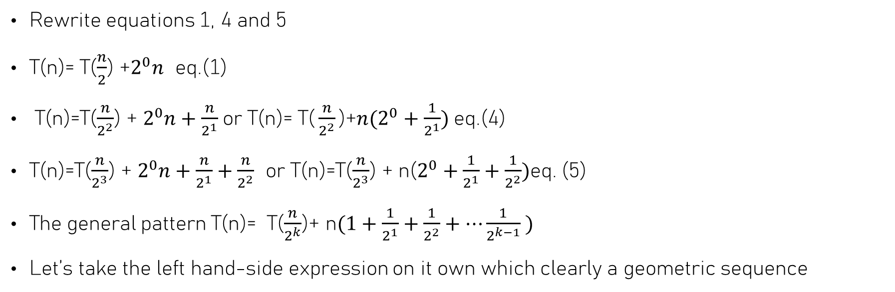
Example 5 (hard)
Rewrite equations 1, 4 and 5
T(n)= T($\frac{n}{2}$) +$2^{0}n$ eq.(1)
T(n)=T($\frac{n}{2^{2}}$) + $2^{0}n+\frac{n}{2^{1}}$or T(n)= ${\text{T}\text{(}\frac{n}{2^{2}}\text{)}\text{+}n(2}^{0}+\frac{1}{2^{1}})$eq.(4)
T(n)=T($\frac{n}{2^{3}}$) + $2^{0}n+\frac{n}{2^{1}}+\frac{n}{2^{2}}$ or T(n)=T($\frac{n}{2^{3}}$) + n($2^{0}+\frac{1}{2^{1}}+\frac{1}{2^{2}})$eq. (5)
The general pattern T(n)= T($\frac{n}{2^{k}}$)+ n$(1+\frac{1}{2^{1}}+\frac{1}{2^{2}}+…\frac{1}{2^{k−1}} )$
Let’s take the left hand-side expression on it own which clearly a geometric sequence

Slide 21
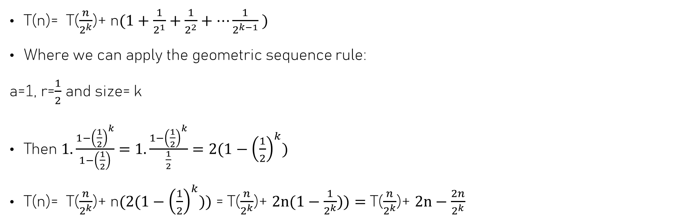
Example 5 (hard)
T(n)= T($\frac{n}{2^{k}}$)+ n$(1+\frac{1}{2^{1}}+\frac{1}{2^{2}}+…\frac{1}{2^{k−1}} )$
Where we can apply the geometric sequence rule:
a=1, r=$\frac{1}{2}$ and size= k
Then $1.\frac{1−{\left(\frac{1}{2}\right)}^{k}}{1−\left(\frac{1}{2}\right)}=$ $1.\frac{1−{\left(\frac{1}{2}\right)}^{k}}{\frac{1}{2}}=2(1−{\left(\frac{1}{2}\right)}^{k})$
T(n)= T($\frac{n}{2^{k}}$)+ n$(2(1−{\left(\frac{1}{2}\right)}^{k}))$ = T($\frac{n}{2^{k}}$)+ $2n(1−\frac{1}{2^{k}}))=$ T($\frac{n}{2^{k}}$)+ $2n−\frac{2n}{2^{k}}$

Slide 22

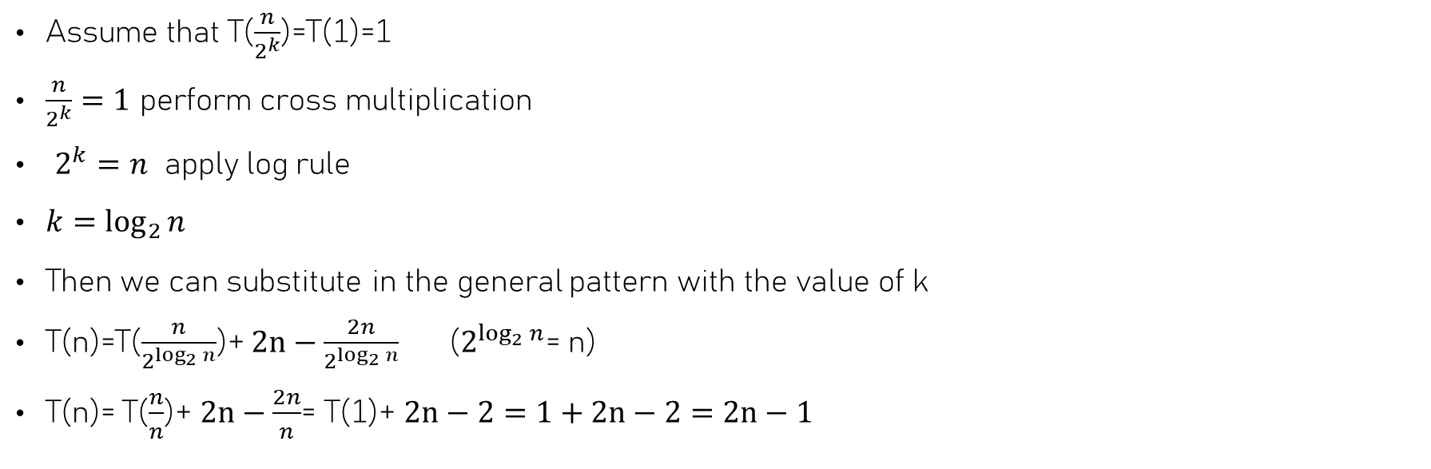
Example 5 (hard)
Assume that T($\frac{n}{2^{k}}$)=T(1)=1
$\frac{n}{2^{k}}=1$ perform cross multiplication
$2^{k}=n$ apply log rule
$k=\log_{2}{n}$
Then we can substitute in the general pattern with the value of k
T(n)=T($\frac{n}{2^{\log_{2}{n}}}$)+ $2n−\frac{2n}{2^{\log_{2}{n}}}$ ($2^{\log_{2}{n}}$= n)
T(n)= T($\frac{n}{n}$)+ $2n−\frac{2n}{n}$= T(1)+ $2n−2=1+2n−2=2n−1$
Θ(n$)$

Slide 23

Empirical Analysis of Algorithms

Slide 24
What is Empirical Analysis
Empirical analysis involves "testing it in the real world." Rather than examining the Mathematical analysis alone, you execute the code and observe the actual outcomes.

Slide 25
Why use Empirical Analysis
Sometimes math says an algorithm is fast, but "hidden constants" (like memory access or overhead) make it slow in practice.
Sometimes you can use Empirical Analysis to prove the mathematical analysis of the algorithm is correct.
Lastly, in some cases, mathematical analysis for algorithms has proved to be very difficult to analyze with precision and certainty.

Slide 26
Perform empirical analysis
Prepare a program implementing the algorithm (or algorithms) for experimentation
Decide on characteristics of the input sample (its range, size, and so on).
Generate a sample of inputs.
Decide on the efficiency metric M to be measured and the measurement unit(an operation count vs. a time unit).
Run the algorithm (or algorithms) on the sample's inputs and record the data observed.
Analyze the data obtained.

Slide 27
Perform empirical analysis
Setup
Implementation of the algorithm
Data collection
Execution time
Visual analysis
X-axis is n
Operation count
Y-axis is time or count
comparison
Compare with mathematical analysis if available
Set parameters

Slide 28
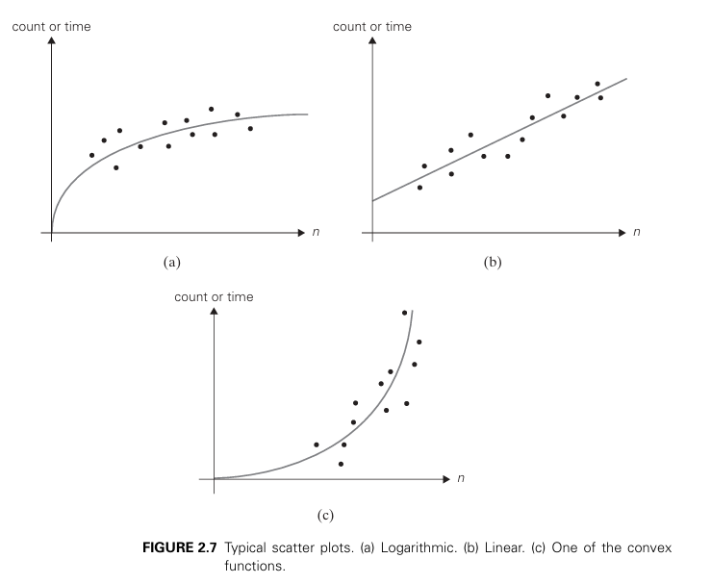
Empirical Analysis Example
Book: Introduction to the Design and Analysis of Algorithms

